Slide 1


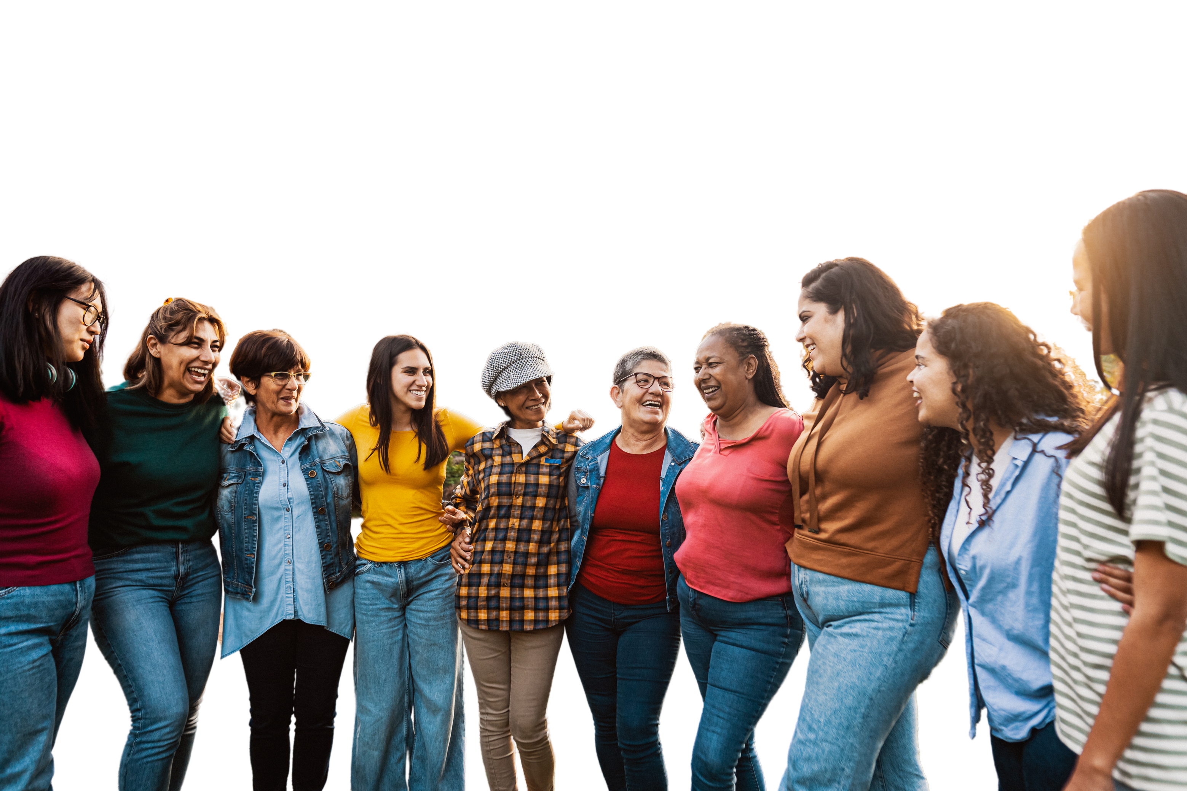
CBWOQ Sunday

Slide 2
Our Vision
We are empowered women transforming the world as God's beloved

Slide 3
"This means that anyone who belongs to Christ has become a new person. The old life is gone; a new life has begun!
And all of this is a gift from God, who brought us back to himself through Christ.”
2 Cor 5:17-18a NLT

